Slide 1

Barnes Lake 2022 Watershed Management Plan
Prepared for the Barnes Lake Property Association
Submitted By: Ashlee Haviland
June 16, 2023

Slide 2
Components
Information gathering
Lake water quality
Inlet/Outlet water quality
BioSonics mapping

Slide 3
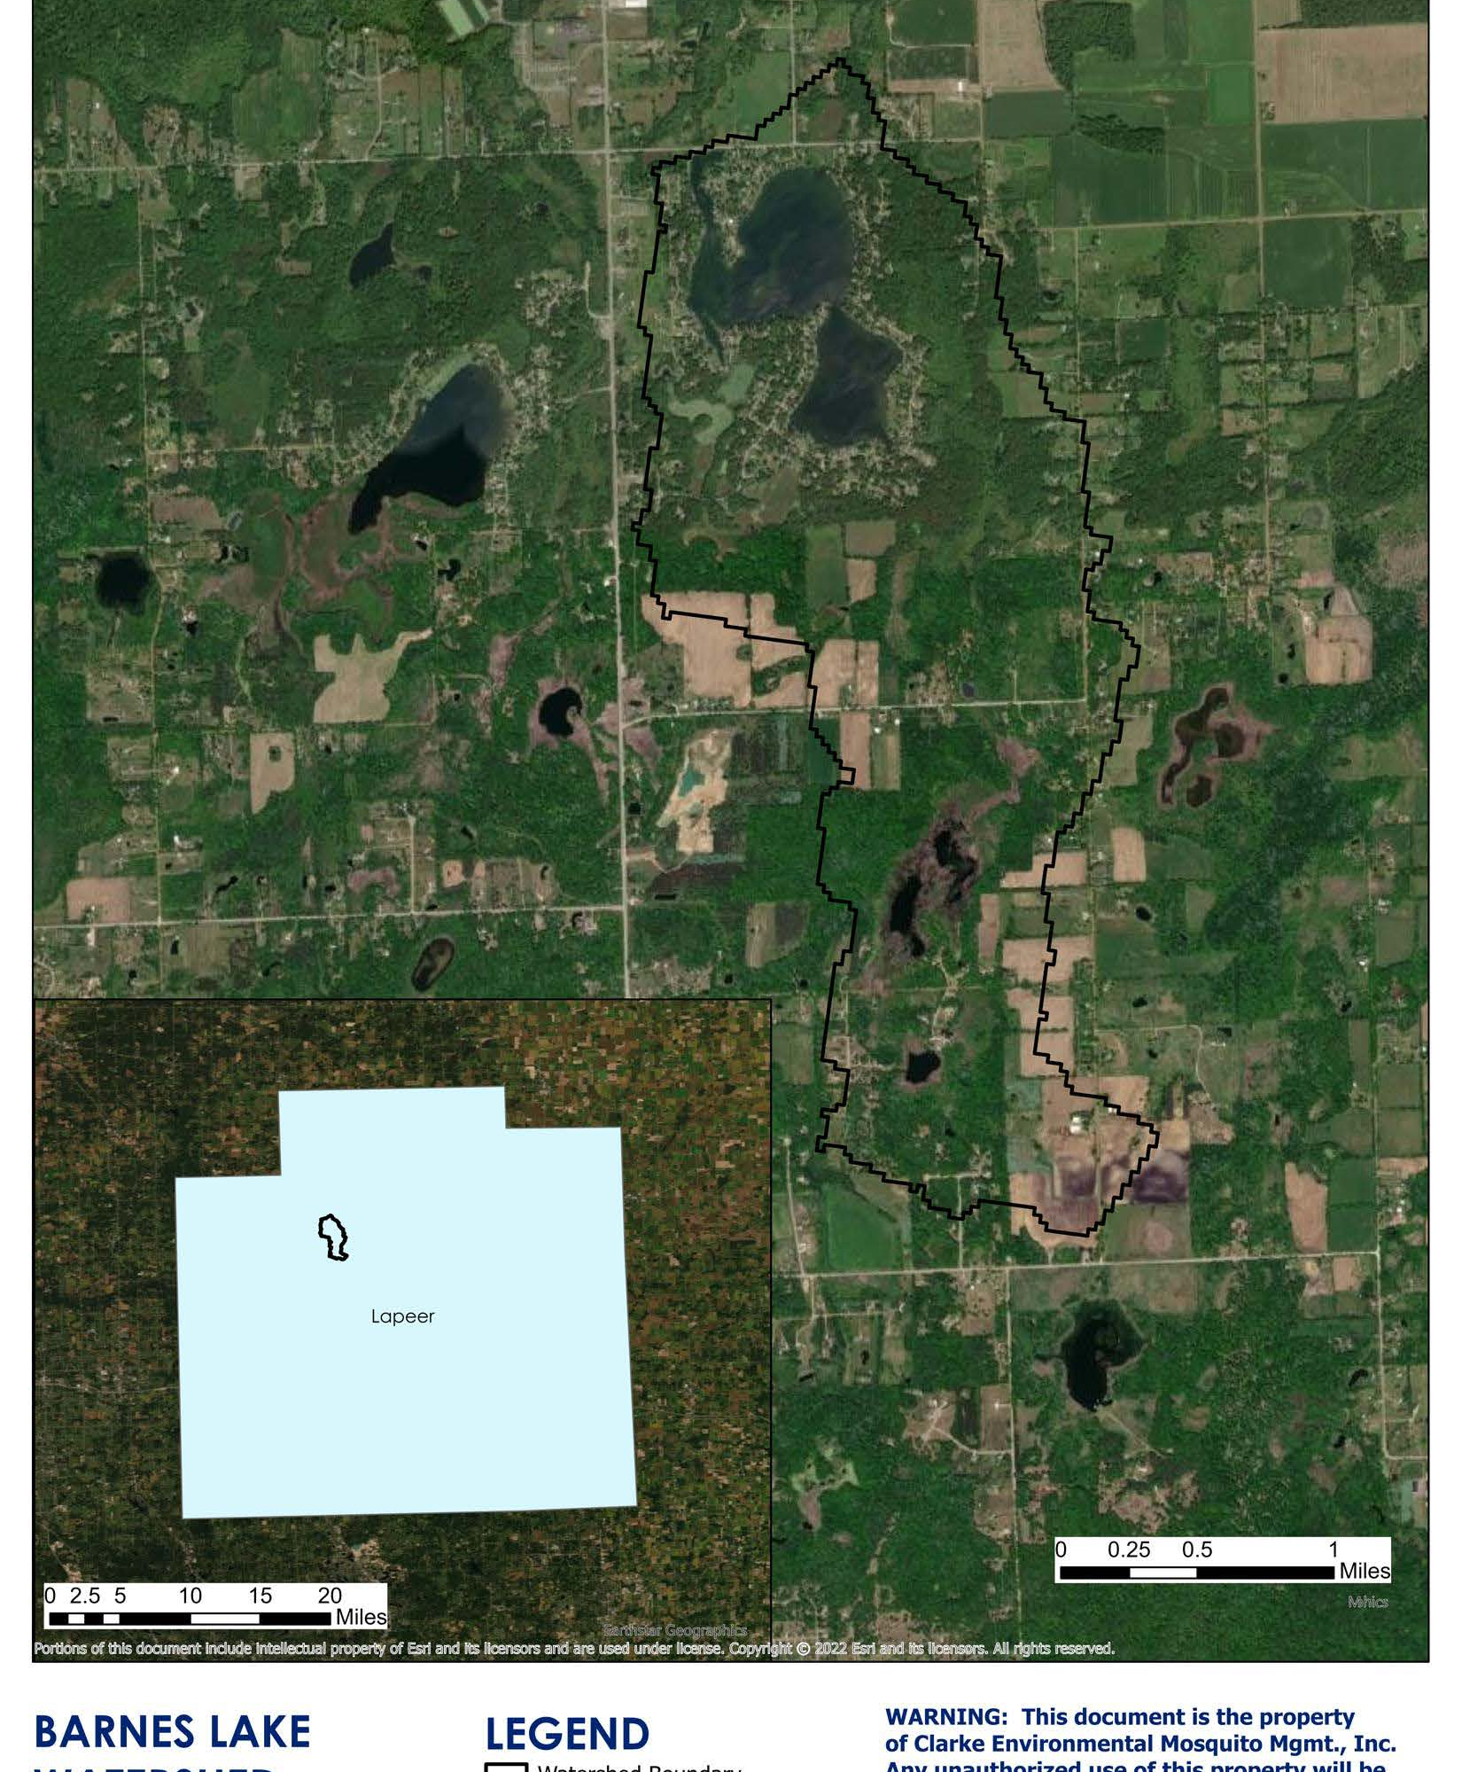
Introduction
Lake is approx. 149 acres
Part of the Crystal Creek watershed
Part of the North Branch Flint River watershed
Barnes Lake watershed drains approximately 1,550 acres (2.4 sq. mi.)

Slide 4
Goals & Objectives
Stable & diverse ecosystem (plants, fish, water quality)
Prevent & control invasive species
Reasonable recreation with minimal impact
Utilize best management practices
Recommendations

Slide 5
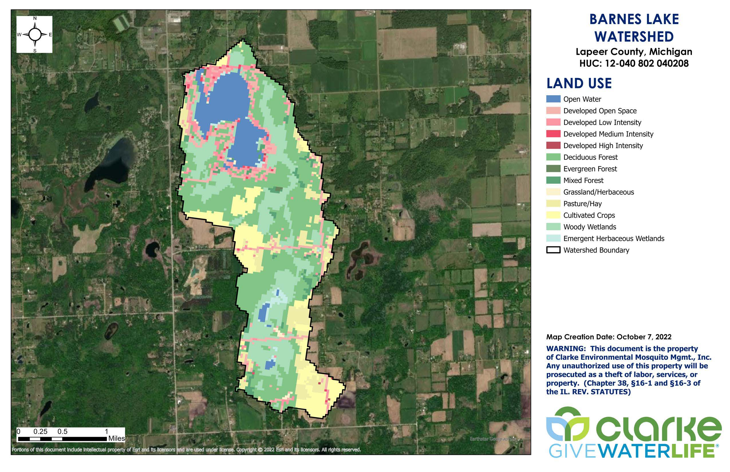
Land Use
Deciduous Forest
33%
Wetlands
22%
Crops
9%

Slide 6
Hydrology
Watershed contains mostly sandy soils
Better infiltration = better filtration, less erosion
High water table = “limited” soils

Slide 7
Aquatic Plant Management
Four (4) Treatments in 2022
All targeted Aquatic Invasive Species (AIS)
  Starry Stonewort
  Eurasian Milfoil
  Curly-Leaf Pondweed
Date | Species Targeted | Acres | Product
April 28, 2022 | Starry stonewort, curly-leaf pondweed | 27.0 | Chelated Copper, Hydrothol 191, Aquathol K
May 31, 2022 | Eurasian watermilfoil, curly-leaf pondweed | 46.4 | Diquat Dibromide, Aquathol K
June 15, 2022 | Starry stonewort | 33.0 | Chelated Copper, Hydrothol 191, Flumioxazin
August 30, 2022 | Starry stonewort | 28.5 | Copper Sulfate, Hydrothol 191, Flumioxazin

Slide 8
Inlet Water Quality
April sampling (High Flow)
  Phosphorus 14.2 ppb <80 ppb (EPA)
  Nitrogen 0.4 ppm <0.6 ppm (EPA)
  TSS 7.5 ppm <25 ppm (AFS)
  Turbidity 3.9 NTU <10.4 NTU (EPA)
  Conductivity 498 uS 150 – 800 uS (AFS)
  Flow Rate 4.75 cfs
        (2,131 gpm)

Slide 9
Inlet Water Quality
July sampling (Low Flow)
  Phosphorus 22.5 ppb <80 ppb (EPA)
  Nitrogen 0.8 ppm <0.6 ppm (EPA)
  TSS 4.0 ppm <25 ppm (AFS)
  Turbidity 3.2 NTU <10.4 NTU (EPA)
  Conductivity 607 uS 150 – 800 uS (AFS)
  Flow Rate 0 cfs

Slide 10
Lake Water Quality
Date | Location | Depth(ft) | Total Phosphorus (ug/L) | Free Reactive Phosphorus (ug/L) | TN (mg/L) | TKN (mg/L) | Conductivity (uS/cm) | Nitrate (mg/L) | Nitrite (mg/L) | Total Nitrate and Nitrite (mg/L) | Chlorophyll a (ug/L) | Total hardness (mg/L as CaCO3) | pH | Alkalinity (mg/L as CaCO3) | Secchi
4/21/2022 | A | Top | 15.0 | <5 | 0.6 | 0.6 | 454 | <0.02 | <0.02 | <0.02 | <10 | 186.6 | 8.4 | 162.9 | 13 feet
 |  | Middle | 32.1 | <5 | 0.5 | 0.5 | 451 | <0.02 | <0.02 | <0.02 | <10 | 185.7 | 8.4 | 164.9
 |  | Bottom | <10 | 5.0 | 0.5 | 0.5 | 448 | <0.02 | <0.02 | <0.02 | <10 | 184.6 | 8.4 | 162.1
 | B | Top | 16.8 | <5 | 0.5 | 0.6 | 463 | <0.02 | <0.02 | <0.02 | <10 | 198.2 | 8.4 | 172.7
Date | Location | Depth(ft) | Total Phosphorus (ug/L) | Free Reactive Phosphorus (ug/L) | TN (mg/L) | TKN (mg/L) | Conductivity (uS/cm) | Nitrate (mg/L) | Nitrite (mg/L) | Total Nitrate and Nitrite (mg/L) | Chlorophyll a (ug/L) | Total hardness (mg/L as CaCO3) | pH | Alkalinity (mg/L as CaCO3) | Secchi
7/12/2022 | A | Top | 12.2 | <5 | 0.7 | 0.7 | 427 | <0.02 | <0.02 | <0.02 | <10 | 139.4 | 8 | 118.6 | 12.9 feet
 |  | Middle | 23.1 | <5 | 0.7 | 0.7 | 432 | <0.02 | <0.02 | <0.02 | <10 | 192.3 | 8.2 | 165.1
 |  | Bottom | 36.3 | <5 | 2 | 2.0 | 410 | <0.02 | <0.02 | <0.02 | 18.2 | 178.0 | 8.2 | 149.5
 | B | Top | 13.9 | <5 | 0.6 | 0.6 | 381 | <0.02 | <0.02 | <0.02 | <10 | 163.3 | 8.7 | 136.9

Slide 11
Temperature & Dissolved Oxygen Profiles

Slide 12
Temperature & Dissolved Oxygen Profiles

Slide 13
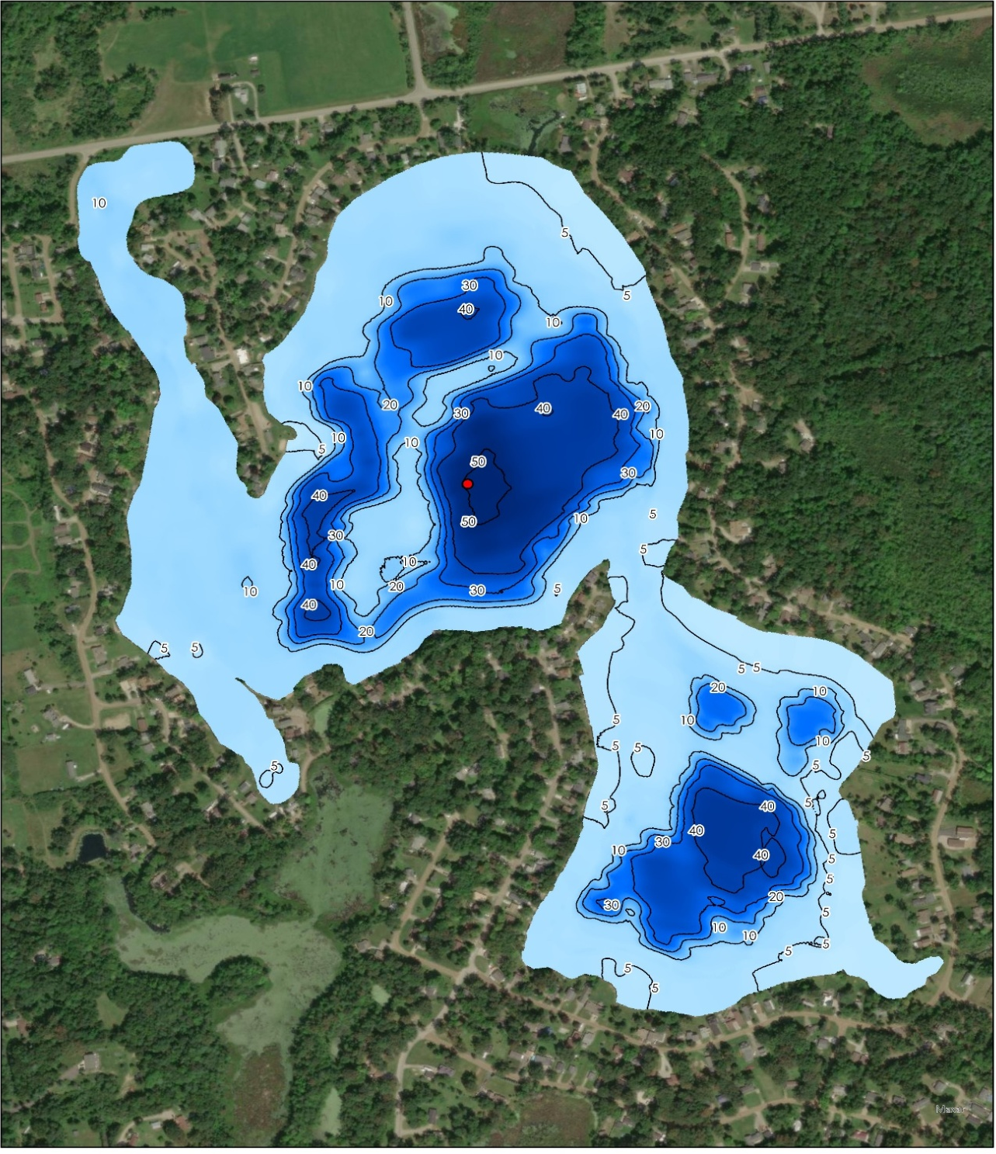
BioSonics - Bathymetry

Slide 14
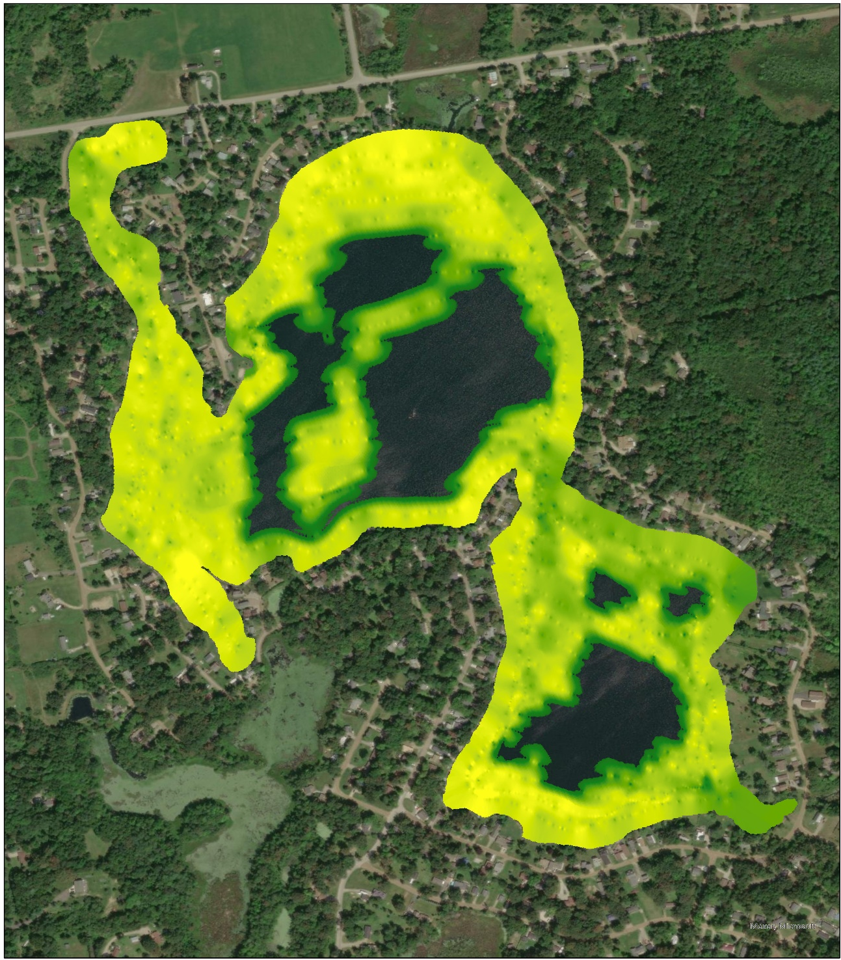
BioSonics – Plant Biomass

Slide 15
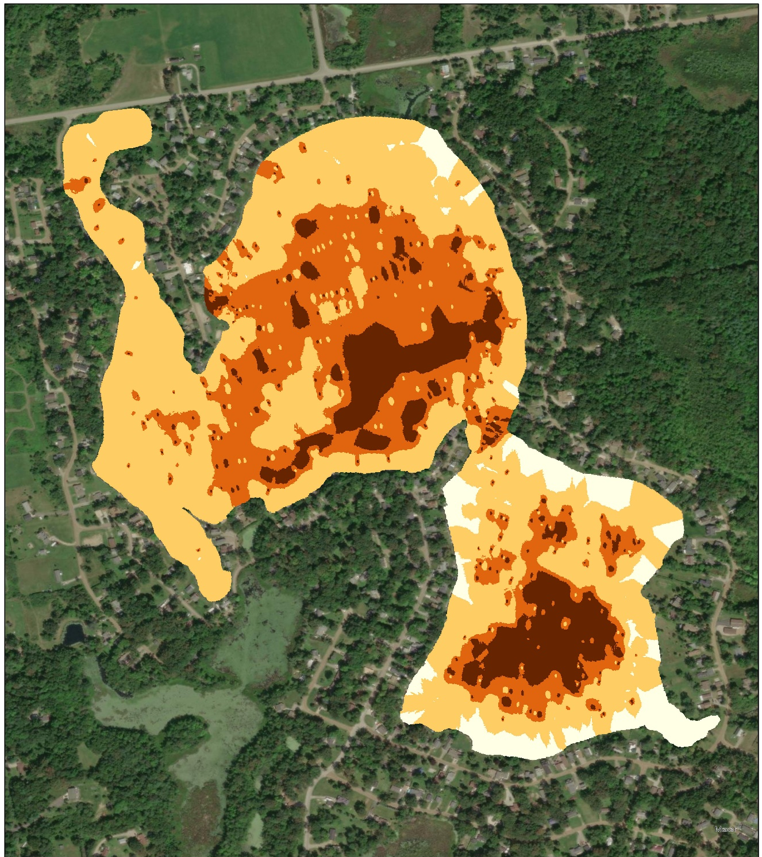
BioSonics - Substrate

Slide 16
Watershed SWOT
  STRENGTHS
  Small watershed
  Limited agriculture
  Plentiful wetlands & forest
  Excellent water quality in the lake

Slide 17
Watershed SWOT
  WEAKNESSES
  Established invasive species
  Septic systems surrounding lake
  Roads present source of pollution

Slide 18
Watershed SWOT
  OPPORTUNITIES
  Continue monitoring
  Better management of AIS
  Implement new projects to protect & improve lake WQ

Slide 19
Watershed SWOT
  THREATS
  Development
  Failing Septics
  New introductions of AIS
  Boat traffic

Slide 20
Action Plan – Future Possibilities
  Similar study in the future
    Continue monitoring water quality
  Aquatic Plant Management (APM)
  AVAS Surveys
  Biological monitoring of inlet & outlet
  Fishery survey

Slide 21
Recommendations for Riparians
  Limit development, especially shoreline
  Improve shoreline habitat
    Low-profile prairie grasses
    Add native species around seawalls
  Replacing seawalls
  Stop the spread of AIS
  Responsible lawn care (fertilizer & clippings)
  Buffer stormwater drainage
  Obey No-Wake zones

Slide 22
Options for Lake Board
  Systemic herbicide for Eurasian Milfoil
  Early treatment for Curly-Leaf Pondweed
  Starry Stonewort: aggressive & often
  Nutrient Mitigation Treatment
  Drawdown
  Inlet Settling Basin

Slide 23
THANK YOU!
  Pete Filpansick
  SOLitude Lake Management
  3390 N State Rd, Suite D
  Davison, MI 48423
  Pete.Filpansick@solitudelake.com
  www.solitudelakemanagement.com

